Slide 1
Pairing

Slide 2
Development The Waterfall Way
Notes:
Now that we’ve talked about Test-Driven Development, it’s time to talk about Development. That is, the work you do to pass tests and deliver value.
First, of course, we’ll look at the Waterfall way.

Slide 3
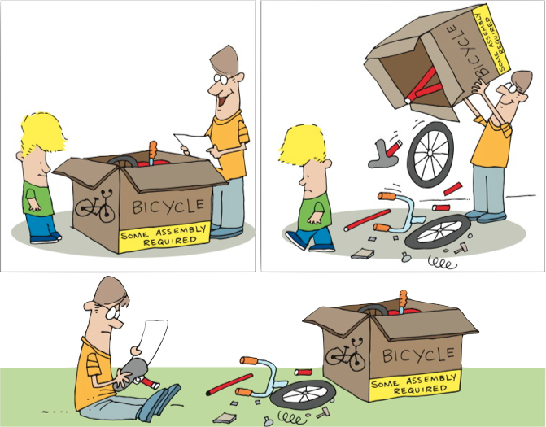
Notes:
We sit down, confident of our ability.
We read the instructions, follow them carefully.
At some point we realize we’ve put widget A into slot 1 as we were told, but we put it in BACKWARDS.
Take it apart to reverse widget A
Let’s consider the classic approach. For those of you who are parents, or who have ever bought anything that says that dreaded phrase “some assembly required” – this example is for you!
Most of us have had the same kinds of experiences. We sit down, confident of our ability to put the thing together. We read the instructions, and we follow them very, very carefully. And, at some point, we realize that we’ve put widget A into slot B, just as we were supposed to, but we put it in BACKWARDS! And now we have to take the thing apart far enough to reverse widget A. And then we get to put it all together again. Sigh.

Slide 4
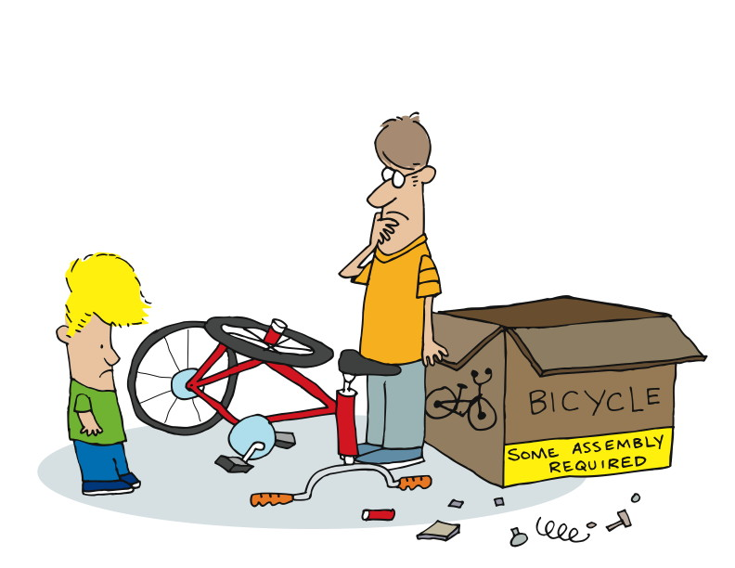
Notes:
Or we get to the end, but it just doesn’t look right.
How can we avoid this?
-----------------------------------------------------------------------------------------------------------------
Or we get all the way to the end, only to find that we’ve somehow managed to put it all together, but it doesn’t look anything like the picture.
Why does this happen? How can we avoid it?
Maybe…

Slide 5
Pairing
Now let’s talk about the reasons you should do it

Slide 6
The Agile Way: Pairing
Notes:
In the module The Origins of Agile Software Development, we talked about Kent Beck and how he came up with Extreme Programming. At that time, we mentioned pairing. Let’s look at pairing in a little more detail now.
Here’s a definition:
“Pair programming is a software development technique in which two programmers work together at one work station. One types in code while the other reviews each line of code as it's typed in. The person typing is called the driver. The person reviewing the code is called the observer or navigator. The two programmers switch roles periodically.
“While reviewing, the observer also considers the strategic direction of the work, coming up with ideas for improvements and likely future problems to address. This frees the driver to focus all of his or her attention on the "tactical" aspects of completing the current task, using the observer as a safety net and guide.”
http://en.wikipedia.org/wiki/Pair_programming
Two of everything is better than one – minds, (pairs of) hands, (pairs of) eyes.
Let’s see why…

Slide 7
“Pair programming is a software development technique in which two programmers work together at one work station. One types in code while the other reviews each line of code as it's typed in. The person typing is called the driver. The person reviewing the code is called the observer or navigator. The two programmers switch roles periodically.
“While reviewing, the observer also considers the strategic direction of the work, coming up with ideas for improvements and likely future problems to address. This frees the driver to focus all of his or her attention on the "tactical" aspects of completing the current task, using the observer as a safety net and guide.”
http://en.wikipedia.org/wiki/Pair_programming

Slide 8
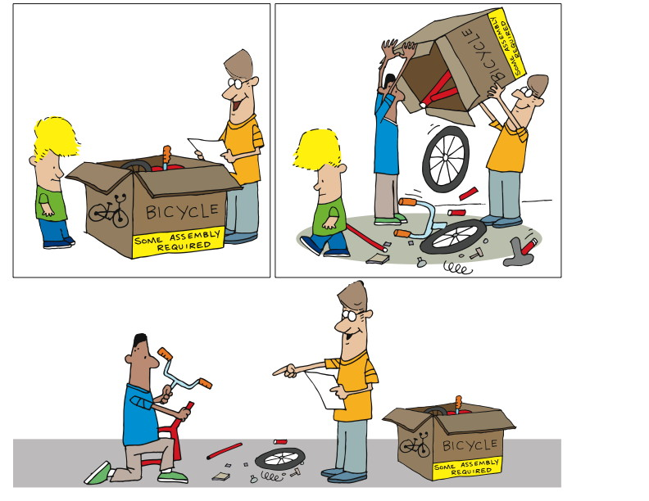
Notes:
We believe that having 2 people working together produces better results.
Better means…
Fewer defects
Less rework
More creativity
Easier to maintain
Sitting side by side
Working on one piece of code
One is the driver – hands on the keyboard and mouse
Two is navigating, doing code review, asking questions, maybe doing research
Change roles periodically
Instead of being distracting, it turns out to be helpful, useful
-----------------------------------------------------------------------------------------------
Unlike in our classical approach, in Agile we believe that having two people working together produces better results. That is, by “better” we mean that there will be fewer defects, less rework, more creativity, and the results will be easier to maintain.
So in actual practice, pairing would say that there are two people sitting side by side, working on one piece of code together. One – as it said in the definition – is the driver, with hands on keyboard and mouse. The other will be navigating – doing real-time code review, asking questions, maybe doing a little research on the side. They will be bouncing ideas off each other. They will change roles periodically.

Slide 9
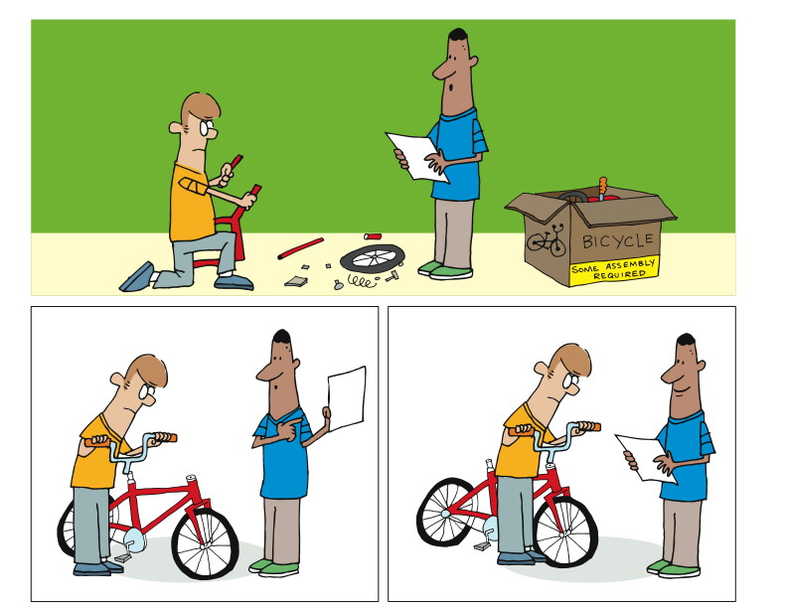
Notes:
By switching roles,
they stay fresh,
check each other’s work and
get done faster
Instead of low morale, you get collaboration, quality and camaraderie
Let’s talk about quality
2 heads are better than 1 – solution is likely to be better
Will see the problem AS IT HAPPENS. If they are paying attention.
--------------------------------------------------------------------------------------------------------------------------
The driver becomes the navigator and the navigator becomes the driver. Between the two of them, they manage to stay reasonably fresh, to check each other’s work, and to get done faster.
Yes, faster.
But let’s get back to fewer defects. We’re all familiar with the adage “two heads are better than one.” This means that having two people thinking about the same problem is likely to produce a better solution than one working alone.
After all, if one of us is looking at the directions, and the other is putting the thing together, the odds are in our favor that the one looking at the directions and the pictures will notice that widget A is in slot B the wrong way AS IT HAPPENS.

Slide 10
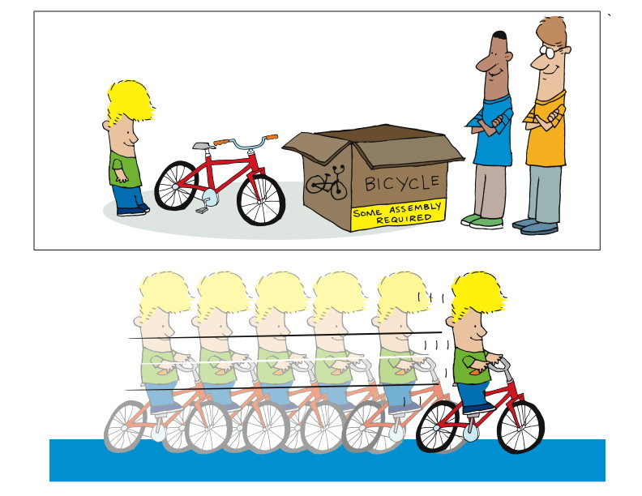
Notes:
Now let’s get back to faster.
2 people doing the work of one?
Cost me 2x as much?
No to both.
Let’s take a bigger, longer view of the challenge.
-----------------------------------------------------------------------------------------------------------------------
We hear repeatedly “but doesn’t that mean that I have two people doing the work of one? Doesn’t’ that mean that it will cost me twice as much, or take twice as long, to get the same thing done?”
There are two answers to that, and both of them are “no”.
In order to understand the answer, you have to take a bigger and longer view of the challenge.

Slide 11
Notes:
It drives around the point when you find the defect.
If found after, I have to:
Undo what I’ve done
Redo it
Double checking other widgets
You could say that the one defect took 3 x the time and money
Now for the longer view.
If I leave widget A backwards, then
Slowly over time there is wear on widget A
It has to be replaced
Now I have to find the problem
Undo what I’ve done
Redo it
Double checking other widgets
Let’s get back to putting widget A the wrong way in slot B. In that case, I have to undo all the work I’ve done from the time I put widget A into slot B, right? Then I have to redo all the work I’ve done since then, double-checking my work to make sure I’m not putting any other widgets in backwards. That means that one single, solitary defect caused me to spend THREE TIMES the time and money to get the same job done. What if I’d caught that defect earlier? Then my cost might be 10% over, not 200% over.
Okay – that’s a relatively easy one. Now we’ll take the longer view…
Imagine that I get it all put together, and it works like a charm. Even though widget A is in slot B backwards, the thing works. But what’s happening is that widget A is slowly wearing, to the point that instead of having a life of five years, it has a life of five months! Assuming that everything else is working fine, all I have to do is disassemble the thing, get a new widget A, put it into slot B properly (assuming I figured out why it failed in the first place), and then rebuild the thing.
Yes, I just spent more like 500% of the original time, as compared to 300% if I catch it before I’m done in the first place, or 110% if I catch it as early as possible. Why 500%? Well, it might be 400%, and it might be 5,000%. The thing is, studies show that the cost of changing something when software is in production is DRAMATICALLY higher than changing it just after it’s done.
So if the minimal cost to fix one defect late in the game is 300%, and the cost of catching it and fixing it early is 110% or less, then if I catch just one bug in one piece of code at the time my pair is putting it in, I’ve just saved at least 80% in cost.
Let’s go over that…

Slide 12
Pairing
Why it sucks, and why you should hate it
Notes:
Ask audience for disadvantages they can think of

Slide 13
Its distracting!
Hard to focus on the problem at hand when your pair is sitting next to you talking

Slide 14
Developers tend to waste a lot of time on:
Facebook, Mail Forwards
Checking Cricket score
Long phone calls
Pairing forces you to:
Keep phone calls short
Avoid distractions

Slide 15
Costly
Two people doing the work of one

Slide 16
110% * 2 = 220%
300%
300% - 220% = 80%
8 hours * .8 = 6.4 hours
6.4 * US$40 = US$256
US$256 * 1000 = US$256,000
Notes:
Catch a bug when working on it costs me 110% of the cost of development x 2 developers
Compared to 300% cost to fix when work is done or later.
Let’s say it took 8 hours to originally build the code.
$256 to fix the one bug.
What if there are 1000 bugs. Not unreasonable for a fairly large sized application.
Consider time 64,000 hours. About 160 person days.
------------------------------------------------------------------------------------------------------------------------
If it costs me 110% for two people, that’s 220%, right? So having two people working together, where they catch and fix one bug, costs 220%. Of course, they’ll catch and fix far more than one. But we’ll stick with just one for the moment.
Compare to that the cost to fix the bug after all the work is done. That’s 300% or higher, because we have to do all the work to figure out where the bug is, refresh our minds about the code, go fix the code, write a new test or two, verify that we haven’t broken anything, check to make sure whether anything else is affected by this change,…
Well, as you can see, the costs mount up very quickly.
For the sake of argument, we’ll say that it took eight hours to develop the code. Then the delta is 6.4 hours (eight hours times 80%).
Again, for the sake of argument, let’s say our developer gets paid forty dollars per hour. That’s a difference of $256. That means that without pairing, it could cost us $256 to fix this one bug if it’s caught late, rather than early.
$256 is not such a big deal, right? What if we expect to find and fix a measly one thousand bugs during the course of our development.
That’s two hundred fifty-six thousand dollars! That’s not small. And one thousand bugs is a small number for a sizable project.
And let’s not forget the time. That $256,000 also represents 6,400 person hours of effort! If we maintain the same size staff, that’s 160 person days added to our schedule, which is NOT included in our project plan.
As we consider this, also consider that 300% is pretty minimal, when you consider that the bug was probably found by QA or by a customer, so there’ll be time to reproduce it, document it, and report and track it. And of course once it’s supposedly fixed, there’s the cost of retesting and reverifying.
You can see that in the Agile community, there’s a strong argument in favor of pairing from many perspectives.

Slide 17
Low morale
Only spend 50% of your time doing any actual work

Slide 18
Other references
Public demo - http://blogs.agilefaqs.com/2010/06/13/pair-programming-public-demo/
Blog by Fred George - http://processpeoplepods.blogspot.com/search/label/Pair%20Programming
Based on a survey
100% agreed that they had more confidence in their solution than when they program alone
96% agreed that they enjoy their job more than when programming alone
http://www.google.co.in/url?sa=t&source=web&cd=5&ved=0CDcQFjAE&url=http%3A%2F%2Fciteseerx.ist.psu.edu%2Fviewdoc%2Fdownload%3Fdoi%3D10.1.1.140.1522%26rep%3Drep1%26type%3Dpdf&ei=sawtTMT3C9DCrAeCt_HzBQ&usg=AFQjCNFtguL_Wf_1aHLgr8Z0gjZ4YbvSLQ&sig2=vleHOi_mQ6rKMI-G2jmPtw

Slide 19
Stop slowing me down!
Explaining thoughts to my pair will slow me down

Slide 20
Pairing leads to:
Faster Knowledge Transfer
Everyone understands and agrees on the Technical architecture and decisions made
Avoid Information Silos

Slide 21
How to Pair http://www.wikihow.com/Pair-Program
Start with a reasonably well-defined task before you sit down
Agree on one tiny goal at a time
Rely on your partner, support your partner
Talk a lot!
Sync up frequently
Take a moment to celebrate as you complete tasks and overcome problems
Switch roles often—at least every 15 min

Slide 22
Pairing Infrastructure

Slide 23
Monitors
One Monitor
Both Pairs are looking at the same location
Smaller Desktop
Two Monitors – Mirrored
Pairs not looking at the same location
Smaller Desktop
Conversations don’t come as easily
Two Monitors – Spanned
Both Pairs are looking at the same location
One Huge Desktop
Enables more non-verbal communication

Slide 24
Keyboard and Mouse
One Shared
Encourages Communication
Must either express yourself or ask for the keyboard
Two (One for each person)
Faster to take control
Less physical movement

Slide 25
Pair Rotation Techniques
Timer / Chess Clock
Encourages rotation of roles within a pair
Driver swapping
Pair Stair/Pairing Matrix
Encourages working with everybody
H
G |  |  |  |  |  |  |  | 1
F |  |  |  |  |  |  | 2 | 3
E |  |  |  |  |  | 1 | 3
D |  |  |  |  | 2
C |  |  |  | 1
B |  |  | 2 | 3
A |  | 1 | 3 |  |  |  |  | 2
 | A | B | C | D | E | F | G | H
Notes:
Explain Pairing Matrix

